Slide 1

Glucose-TOR-PRC2 Signaling
Controls Plant Development
Ruiqiang Ye (叶瑞强)
2022-12-2

Slide 2
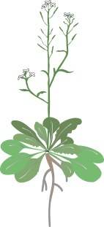

Glucose Functions as a Regulatory Signal in
Controlling Plant Development
Flowering
Silique
Glucose
Branching
O₂
Shoot
meristem
CO₂
Leaf
patterning
Root
meristem
H₂O

Slide 3
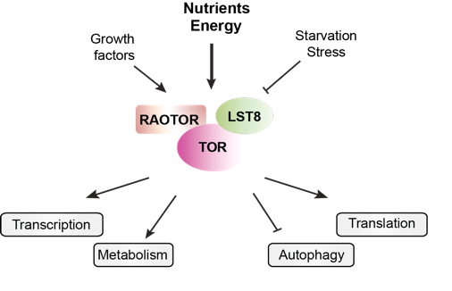
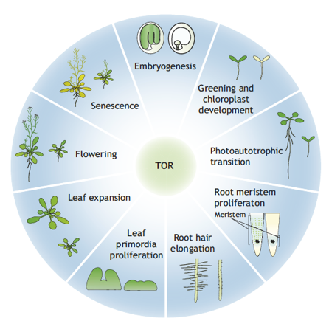
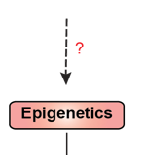
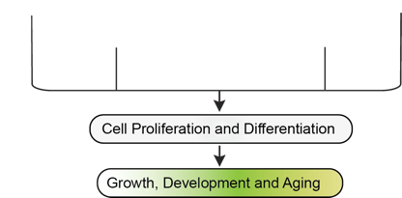
The TOR Signaling Network & Plant Development
TOR complex
Shi et al., Development 2018

Slide 4
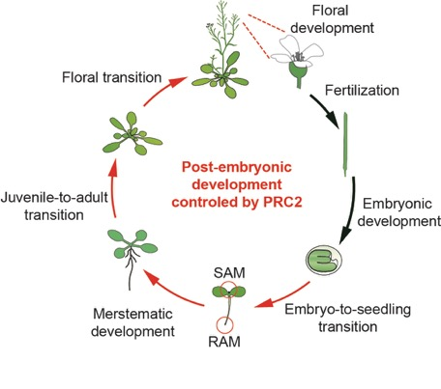
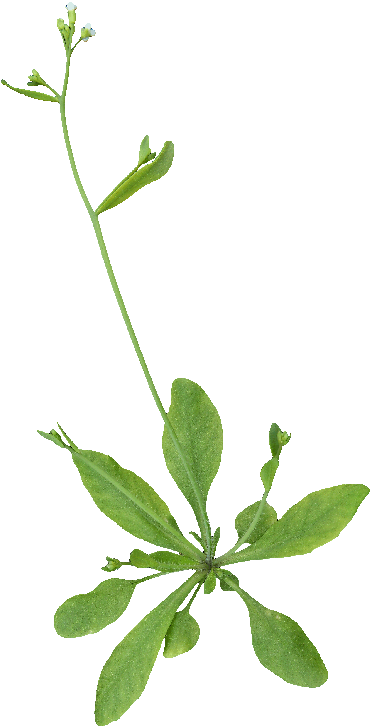
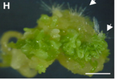
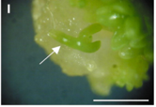
PRC2 Mediates Cell Differentiation and Developmental Transitions
WT
PRC2 mutants
clf,swn
fie
Polycomb repressive complex 2 (PRC2)
Chanvivattana et al., D2004
Bouyer et al., PLOSg2011

Slide 5
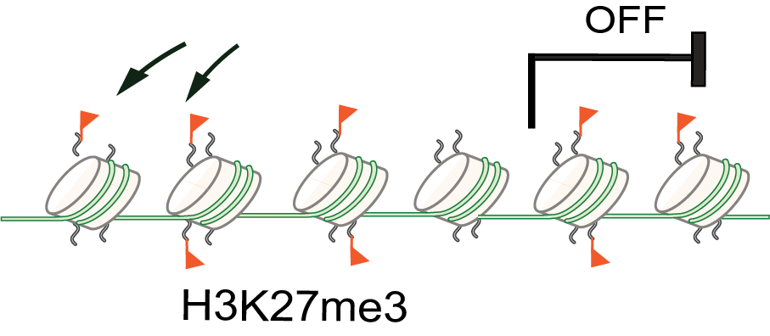
PRC2 Catalyzes the Deposition of H3K27me3
PRC2
complex
Regulatory genes
Arabidopsis
Drosophila
Mammals
Does TOR signaling regulate H3K27me3 dynamics
in plant development?

Slide 6
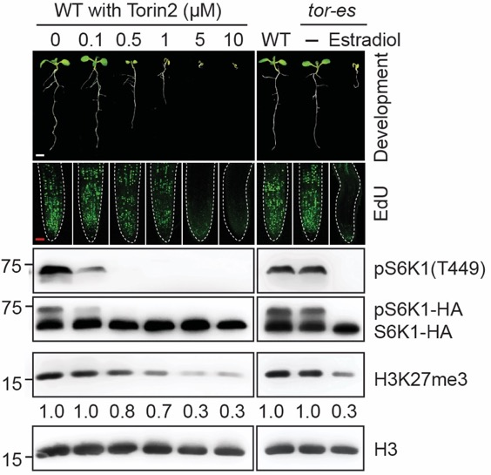
Distinct TOR Activity Thresholds
Regulate H3K27me3 and Plant Development
Torin2
ATP-competitive TOR inhibitor
tor-es
inducible null mutant
EdU
DNA replication
pS6K1
TOR activation
translational control
H3K27me3
epigenetic mark
gene silencing
developmental transition

Slide 7
TOR Specifically Modulates Global H3K27me3
Immunoblot
ChIP-seq

Slide 8
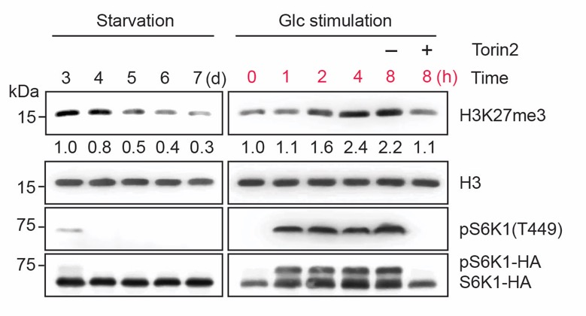
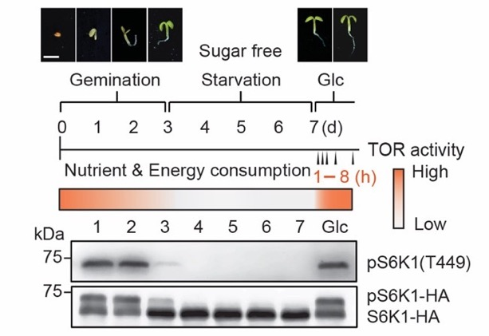
Glucose Rapidly Stimulates TOR Activity
and de novo H3K27me3 Accumulation

Slide 9
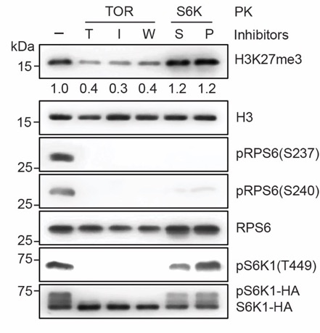
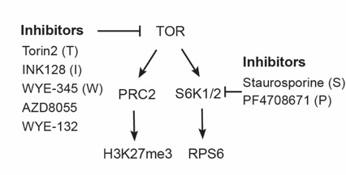
TOR Affects H3K27me3 Independent of S6K

Slide 10
Summary
Nutrients (Glucose)
TOR
TOR is a specific and direct regulator of global H3K27me3
?
Cytosol
H3K27me3
Nucleus

Slide 11
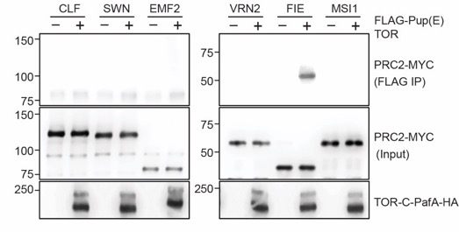


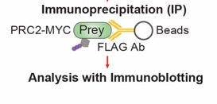
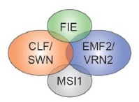
TOR Specifically Interacts with FIE in PRC2
Proximity-tagging system
pupylation-based interaction tagging(PUP-IT)
PafA: Pup protein ligase
PRC2 in Arabidopsis

Slide 12




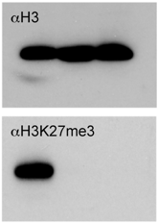
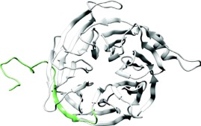
FIE Is Essential for Genome-Wide H3K27me3
Drosophila
Mammals
Arabidopsis
WT fie-1 fie-2
WD-repeats
Bouyer et al., PLOSg2011

Slide 13
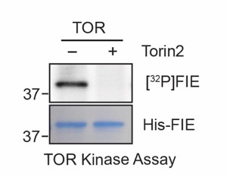
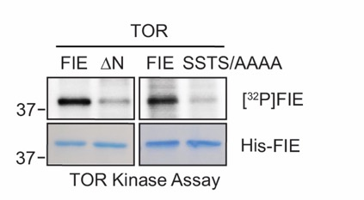
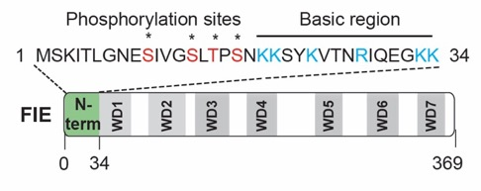
TOR Phosphorylates the N-terminus of FIE
Phosphorylation sites identified within the N-terminus by mass spec

Slide 14
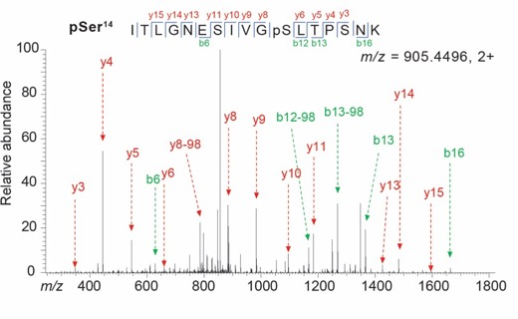
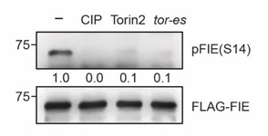
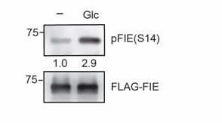
Glucose-TOR Signaling Phosphorylates FIE

Slide 15
Summary
Nutrients (Glucose)
TOR is a specific and direct regulator of global H3K27me3
TOR interacts with and directly phosphorylates FIE, an essential subunit of PRC2
P
TOR
FIE
?
Cytosol
H3K27me3
Nucleus

Slide 16
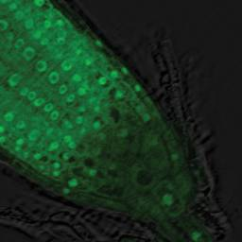
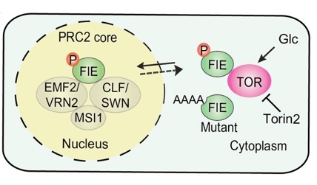
Does TOR Regulate the Localization of FIE?
GFP-FIE is localized in both the nucleus and cytosol
Oliva et al., J Exp Bot 2016

Slide 17
TOR Activity is Required for Nuclear Localization of GFP-FIE

Slide 18
Phosphorylation of FIE
Promotes its Nuclear Localization

Slide 19
Summary:
Nutrients (Glucose)
P
TOR
TOR is a specific and direct regulator of global H3K27me3
TOR interacts with and directly phosphorylates FIE, an essential subunit of PRC2
Phosphorylation of FIE by TOR promotes its nuclear localization
FIE
Cytosol
Nucleus
P
EMF2/VRN2
FIE
MSlI
CLF/SWN
X
H3K27me3

Slide 20
FIE Phosphorylation Mutation Abrogates H3K27me3 Landscape and Reprograms Transcriptome
TOR-FIE-PRC2 targets

Slide 21
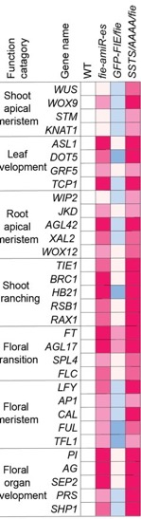
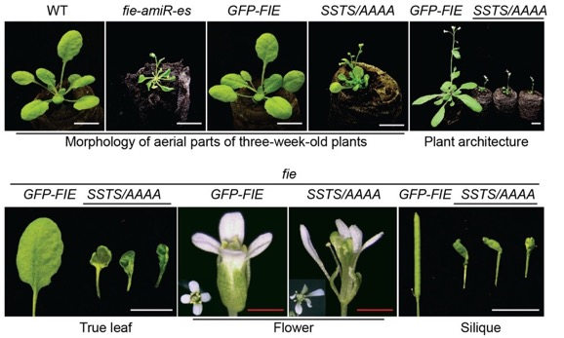

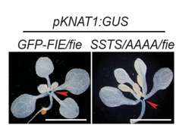


TOR-FIE Signaling Is Central
to Diverse Plant Developmental Programs

Slide 22
Working Model
Ye et al., Nature 2022

Slide 23
Vernalization Activates Floral Transition
via H3K27me3-Mediated FLC Silencing
Vernalization
flowering induction by prolonged cold treatment
Flowering repressor: FLOWERING LOCUS C (FLC)
Before cold
Cold exposure
Post cold
Progressive and stable repression of FLC expression
Nucleation and spreading of H3K27me3 at FLC locus
C Dean
Nucleation
Spreading

Slide 24


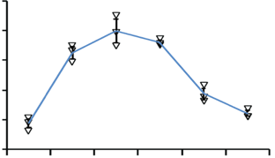
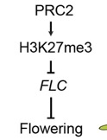
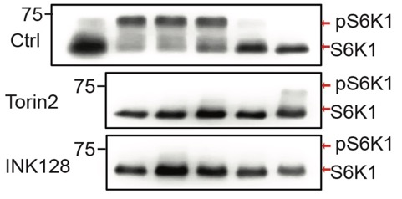
Vernalization Induces Glucose Accumulation and Increases TOR Activity
Before cold
Cold exposure
Post cold
?
NV
V5
V10
V20
V30
T5
NV, non-vernalization
V, vernalization days
T, postcold days at 22°C

Slide 25
Repression of FLC during Vernalization Requires TOR Activity
NV, non-vernalized.
V, vernalization days.

Slide 26
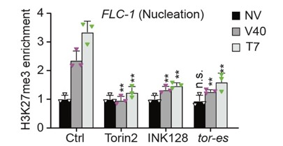
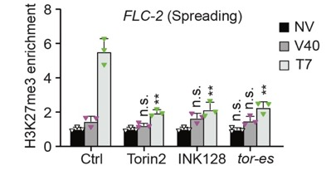
TOR Facilitates H3K27me3 Enrichment at FLC
Before cold
Cold exposure
Post cold
FLC-1
FLC-2
FLC-1
FLC-2
FLC-1
FLC-2
Nucleation
Spreading
C Dean

Slide 27
TOR Activity is Required to Promote Vernalization-mediated Flowering Transition

Slide 28
Prolonged Cold-induced FIE Phosphorylation is Required for Vernalization
NV V10 V20 V30 V40 T7
FIE-pS14
FLAG-IP
FLAG
FLAG
Total extract
Tubulin

Slide 29
Summary
TOR is a specific and direct regulator of global levels of H3K27me3.
TOR interacts with and phosphorylates FIE subunit of PRC2.
TOR-phosphorylated FIE is nuclear-localized and regulates diverse developmental programs.
Glucose-TOR signaling controls vernalization-mediated flowering transition by phosphorylating FIE
Ye et al., Nature 2022

Slide 30
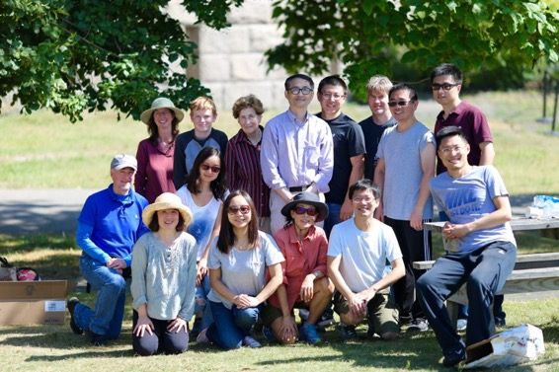
Acknowledgement
Jen Sheen
Hao Du
Lin Shi
Yue Wu
Jinwoo Shin
Odiel Liu
Jenifer Bush
@MGH/HMS
Lin Xu
Yijing Zhang
Meiyue Wang
@CEMPS
Christian Meyer
Albrecht von Arnim
Shu-Hsing Wu
Jake Brunkard & Regina Scarpin
Caroline Dean
Sixue Chen
Shweta Chhajed
Jin Koh
@U Florida

